Slide 1
YOLOv8 Object Detection for Advanced Driver-Assistance Systems
James Overmeyer

Slide 2
Roadmap
Introduction to Object Detection
Object Detection for ADAS
Experimentation with YOLOv8 and RISE
Conclusions

Slide 3
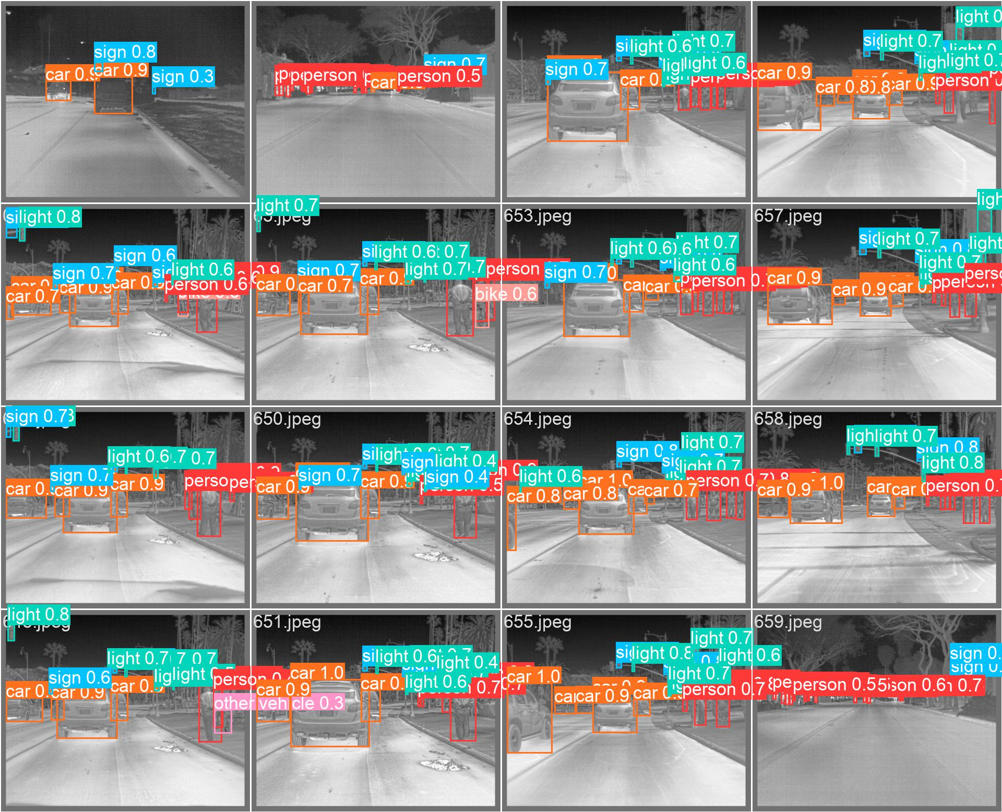
Object Detection
Computer Vision Technique
Identify and localize objects of interest in an image.
Generation of bounding boxes and confidence.
Applications:
Autonomous driving
Security
Healthcare
Example of bounding boxes and confidence predictions
Notes:
Autonomous driving: Object detection is used to detect pedestrians, vehicles, and other obstacles in the road to help self-driving cars make informed decisions.
Security and surveillance: Object detection can be used to detect suspicious activity, track people or vehicles, and identify specific objects, such as weapons or packages.
Retail: Object detection can be used to analyze customer behavior, monitor inventory levels, and identify popular products.
Healthcare: Object detection can be used to identify medical images, such as X-rays, and detect anomalies or specific features.

Slide 4
Two-Stage vs One-Stage Detection
Two-Stage
One-Stage
Regions of interest are proposed. Then objects within the proposed region are classified.
Two separate neural networks
More Accurate
More Complicated
Simultaneous region proposals and object classification.
One neural network
Faster
Less Complicated
Notes:
Two-stage detectors first propose regions of interest and then refine them to improve accuracy.
They are generally more accurate than one-stage detectors, especially when it comes to detecting small objects or objects with complex shapes.
However, they require more computational resources and are slower than one-stage detectors.
They are also more complex to implement and may require more training data.
One-stage detectors predict the class and location of objects in a single pass.
They are known for their fast speed, making them ideal for real-time applications.
They are also simpler to implement and require fewer computational resources.
However, they may sacrifice some accuracy for speed and may struggle to detect small objects or objects with complex shapes.

Slide 5
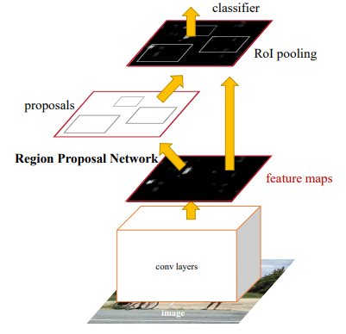
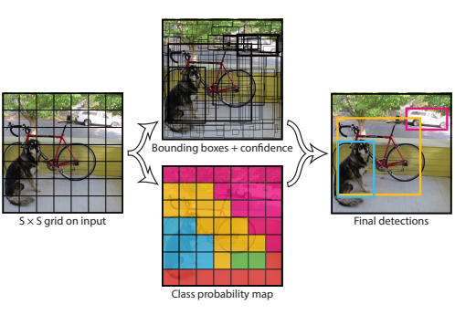
Two-Stage vs One-Stage Detection
Two-Stage
One-Stage
Example of 2-Stage Detection using Faster R-CNN
Example of 1-Stage Detection using YOLO

Slide 6
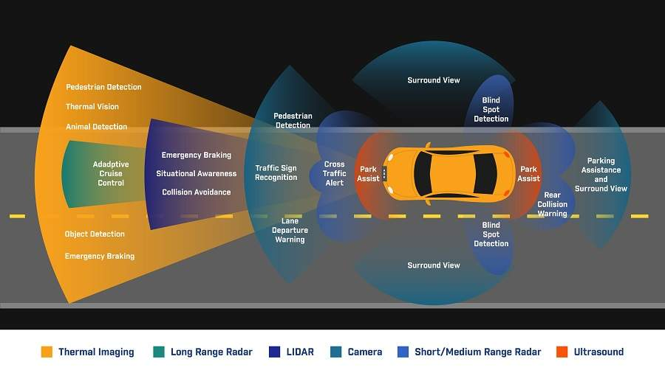
Thermal Object Detection for ADAS
Infrared cameras capture thermal images of the surrounding environment.
Visibility in a variety of weather conditions
Detection of far-away objects
Combine with LiDAR, visible cameras and other sensors for fully autonomous driving systems
Combination of sensors for autonomous vehicles
https://www.roadtraffic-technology.com/wp-content/uploads/sites/17/2018/01/flir-infographic2.jpg
Notes:
Autonomous driving: Object detection is used to detect pedestrians, vehicles, and other obstacles in the road to help self-driving cars make informed decisions.
Security and surveillance: Object detection can be used to detect suspicious activity, track people or vehicles, and identify specific objects, such as weapons or packages.
Retail: Object detection can be used to analyze customer behavior, monitor inventory levels, and identify popular products.
Healthcare: Object detection can be used to identify medical images, such as X-rays, and detect anomalies or specific features.

Slide 7
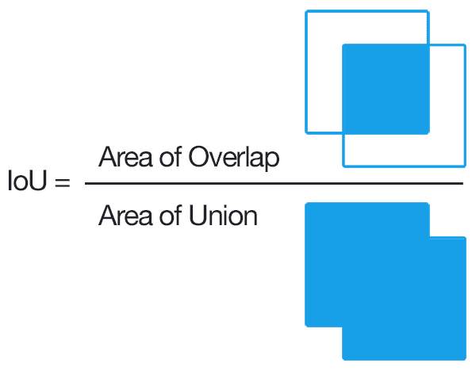
Research on Thermal Object Detection
Akshatha, et al.
55.7% mAP at 8 FPS using Faster R-CNN
25.9% mAP at 44 FPS using SSD
Kos, et al.
30% AP for human detection using YOLOv3
Jiang, et al.
88.9% mAP at 50 FPS for UAV object detection using YOLOv3
mAP is calculated using the recall-precision curve for an IoU threshold
https://www.researchgate.net/figure/Illustration-of-intersection-over-union-IOU_fig5_346512249

Slide 8
YOLOv8 Experiments
Model | Parameters | Training Time | Testing mAP50 | Detection FPS
Epoch-20 Batch-4 Nano | 3.2M | 2 Hrs | 0.3889 | 90
Epoch-40 Batch-16 Nano | 3.2M | 2.5 Hrs | 0.4038 | 90
Epoch-20 Batch-4 Small | 11.2M | 2.25 Hrs | 0.4434 | 85
Epoch-40 Batch-16 Small | 11.2M | 2.5 Hrs | 0.4467 | 85
Epoch-20 Batch-4 Med | 25.9M | 2.75 | 0.4621 | 63
Epoch-40 Batch-16 Med | 25.9M | 3.25 Hrs | 0.5147 | 63

Slide 9
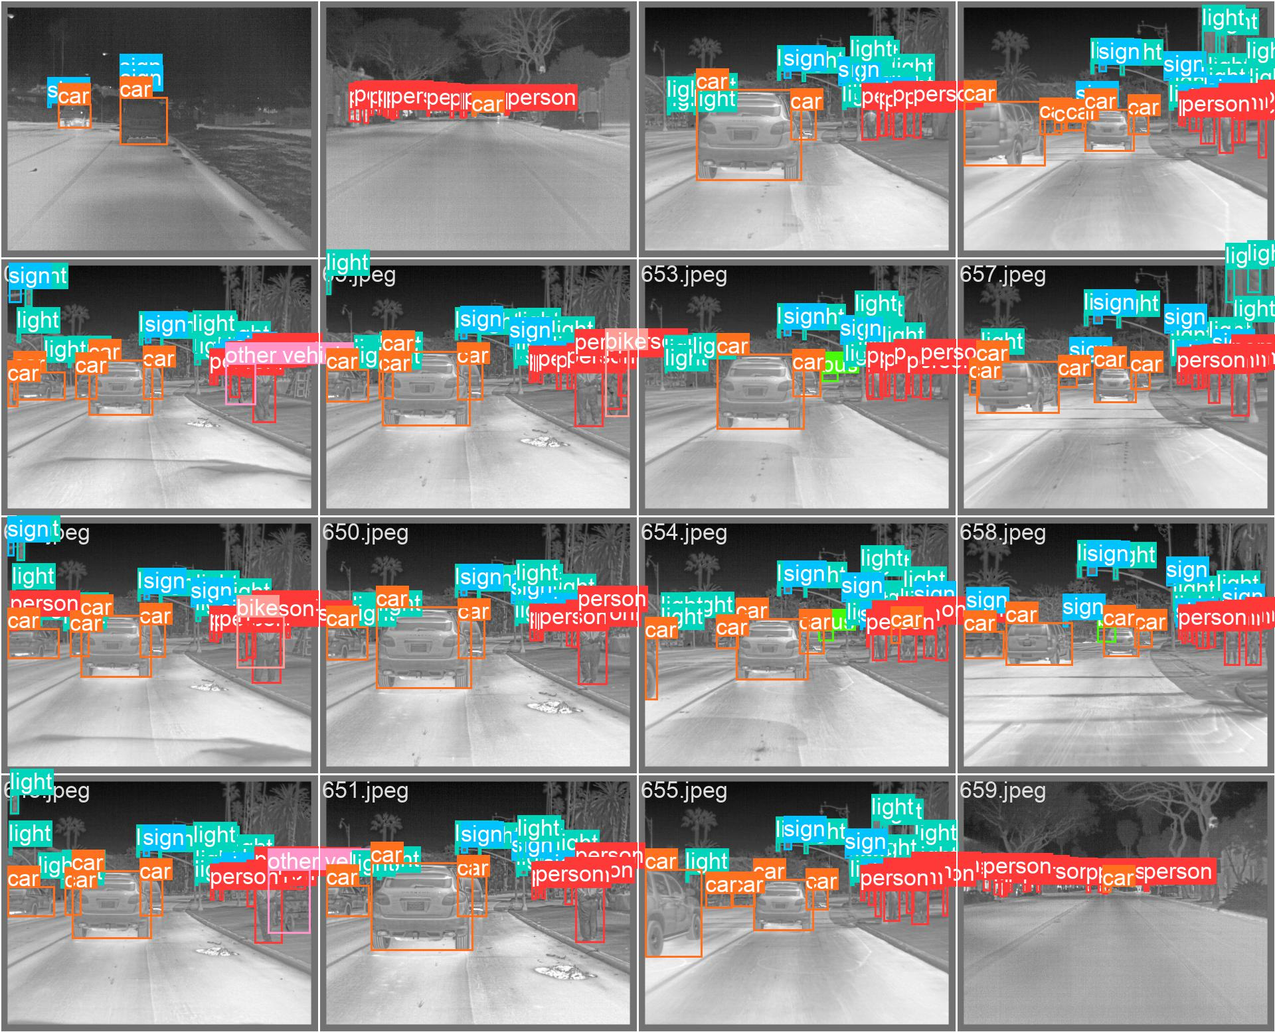
YOLOv8 Detection Example
Original Labels
Predicted Labels

Slide 10
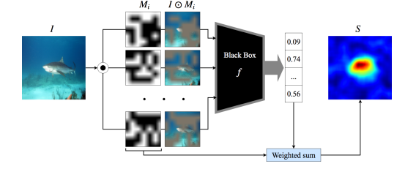
RISE Explainability
Randomly mask an input image many times
Run detection on masked images
If detection specific class is detected add that masked image to the final heatmap
Output a heatmap of important features for detection

Slide 11
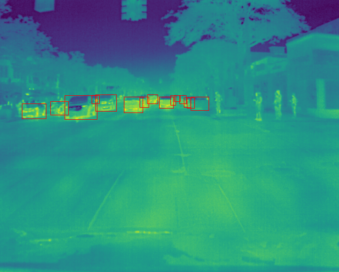
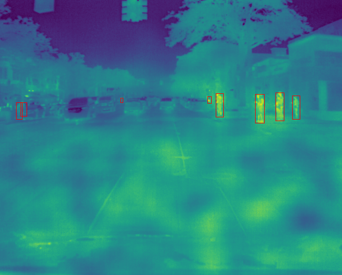
Example RISE Results
Cars
People

Slide 12
Conclusions
YOLOv8 can make real-time detections for common ADAS thermal objects like people and vehicles.
YOLOv8 struggles with accuracy on small objects, so it is important to incorporate YOLOv8 with other ADAS systems
RISE demonstrates that YOLOv8 utilizes contextual information for certain detections, like tires for cars.

Slide 13
References
[1] S.S.A. Zaida, et al, “A survey of modern deep learning based object detection models,” Digital Signal Processing, 2022, vol 126.
[2] K. Oshea, et al. “An Introduction to Convolutional Neural Networks,” 2015.
[3] R. Girshick. “Fast R-CNN,” Proceedings of IEEE International Conference on Computer Vision (ICCV), 2015, pp. 1440-1448.
[4] J, Redmon, et al, “You Only Look Once: Unified, Real-Time Object Detection,” Proceedings of the IEEE Conference on Computer Vision and Pattern Recognition (CVPR), 2016, pp 779-788.
[5] J. Terven, et al, “A Comprehensive Review of YOLO: From YOLOv1 to YOLOv8 and Beyond,” ACM Computing Services, 2023.
[6] K.R. Akshatha, et al. “Human Detection in Aerial Thermal Images Using Faster R-CNN and SSD Algorithms.” Electronics. 2022, 11, 1151.
[7] M Ivasic-Kos, et al,. “Human detection in thermal imaging using YOLO,” ICCTA '19: Proceedings of the 2019 5th International Conference on Computer and Technology Applications. 2019, pp. 20-24.
[8] C. Jiang, et al, “Object detection from UAV thermal infrared images and videos using YOLO models,” International Journal of Applied Earth Observations and Geoinformation, 2022.
[9] M. Kristo, et al. “Thermal Object Detection in Difficult Weather Conditions Using YOLO,” IEEE Access. Volume 8. 2020.
[10] V. Petsiuk, et al, “RISE: Randomized Input Sampling for Explanation of Black-box Models.” Computer Vision and Pattern Recognition (CVPR), 2018.
[11] V. Petsiuk, et al, “Black-box Explanation of Object Detectors via Saliency Maps,” Computer Vision and Pattern Recognition (CVPR), 2021. Oral.
[12] T. Lin, et al, “Microsoft COCO: Common Objects in Context,” European CCV, 2014, pp. 740-755.

